Slide 1
Males vs. Females
Have Women Finally Caught Up To Men?
Employment
Income
Education
Michelle Helfman Final Project – 3/4/2023

Slide 2
Males vs. Females
It’s a man’s world.
A woman’s place is in the home.
A woman doesn’t need equal pay because there’s a man to take car of her.
These are some of the historical perceptions of men and women. Women were expected to take care of the family home and raise children, while men went out into the world earning money to provide for the family. At the same time, women graduated from school at a greater rate than men, but more men graduated from college than women.
It is now 2023, and women have made great strides in the areas of Employment, Education, and Income, but have they caught up with men?

Slide 3
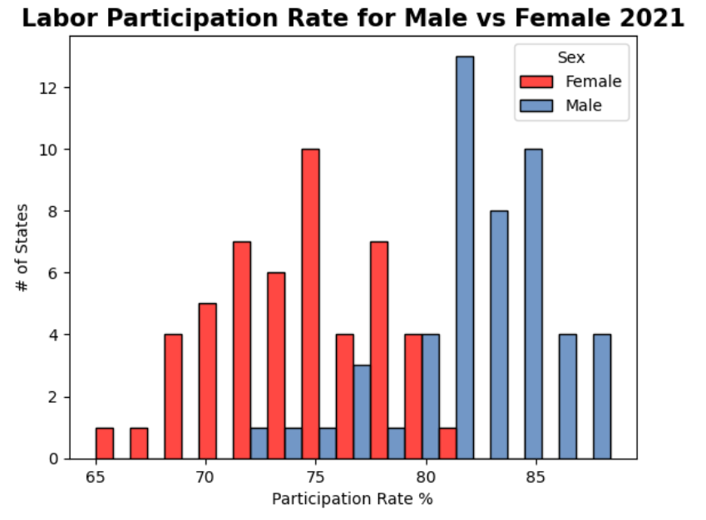
Males vs. Females – Histograms
Labor Participation Rate
In 1960, men dominated the labor market 98/42, more than 50 percentage points over women. In 2021, the difference is eight percentage points, 82/74, still favoring men.
The maximum labor participation rate is 88.4% for men.
The minimum labor participation rate is 65% for women.
Men dominate the top five labor participation rates by state – Utah (88.4), Nebraska (87.2), Minnesota (86.9), North Dakota (86.9), and Wyoming (86.3).
The lowest five participation rates by state are all women – West Virginia (65.0), Alabama (67.8), New Mexico (68.5), Mississippi (68.7), and Kentucky (69.1).
While the gap has closed significantly, men still participate in the labor market at a greater rate than women.

Slide 4
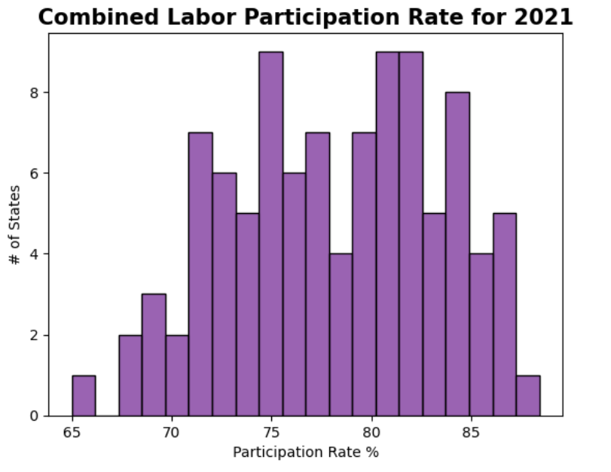
Males vs. Females – Histograms
Labor Participation Rate – Page 2
Observing records for both males and females combined gives a view into the 2021 United States labor participation rate as a whole.
The combined mean is 78.2%
The mode is based on gender.
Male = 81.3%
Female = 81.8%
The combined variance is 28.23.
The combined standard deviation is 5.3.
The outlier is West Virginia at 65%.

Slide 5
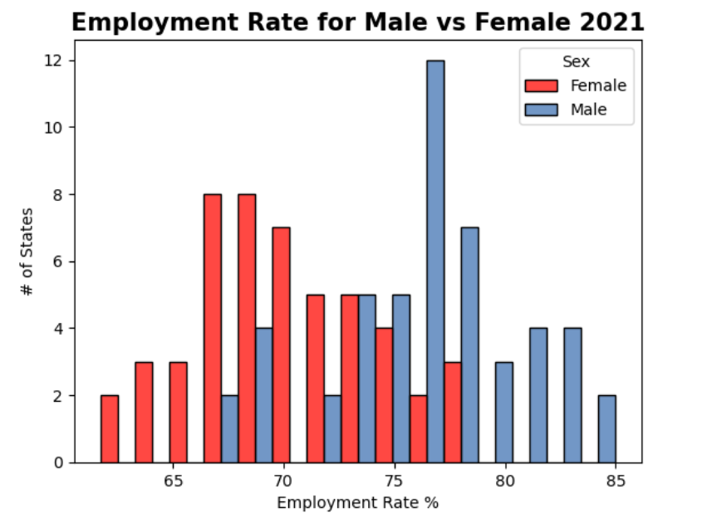
Males vs. Females – Histograms
Employment Rate
Like labor participation, the employment rate in 1960 heavily favored men by 40 percentage points at 78/36. In 2021, the difference is six percentage points, 76/70, still favoring men.
The maximum employment rate is 85% for men.
The minimum employment rate is 61.7% for women.
Men dominate the top five employment rates by state – Utah (85.0), Nebraska (84.3), New Hampshire (82.7), Iowa (82.4), and Minnesota (82.4).
The lowest five employment rates by state are all women – West Virginia (61.7), New Mexico (63.1), Mississippi (64.1), Alabama (64.2), and Louisiana (64.6).
The difference in employment and labor participation rates is the unemployment rate for 2021.

Slide 6
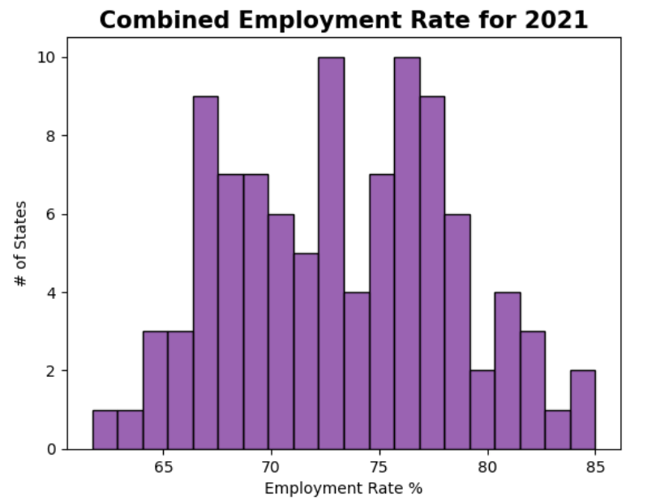
Males vs. Females – Histograms
Employment Rate – Page 2
Observing the combined records for males and females in the United States gives an overall view of the 2021 employment rate.
The combined mean is 73.3%
The mode is based on gender.
Male = 65.9%
Female = 76.1%, 76.7%, and 78.1%
The combined variance is 27.31.
The combined standard deviation is 5.2.
There are no outliers because the records are evenly distributed on both ends of the graph.

Slide 7
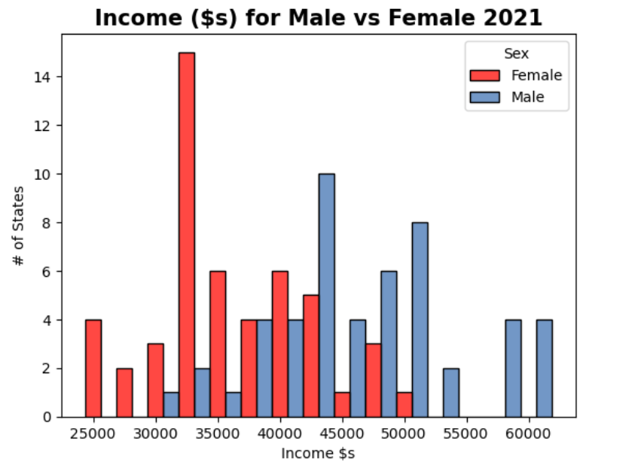
Males vs. Females – Histograms
Annual Income ($s)
In 1960, men earned $43,095*, and women earned $26,148*. Women’s income was 60% of what men earned. In 2021, the wage gap by gender is $46,619 for men and $36,229 for women
The maximum annual income earned is $61,914 by men.
The minimum annual income earned is $24,324 by women.
Men dominate the top five states for annual income – California ($61,914), Maryland ($61,488), Massachusetts ($60,189), Washington ($59,651), and New Jersey ($59,128).
The five lowest annual incomes are all earned by women – Arkansas ($27,159), Louisiana ($26,390), West Virginia ($26,041), Alabama ($25,681), and Mississippi ($24,324).
* Adjusted to 2021 dollars

Slide 8
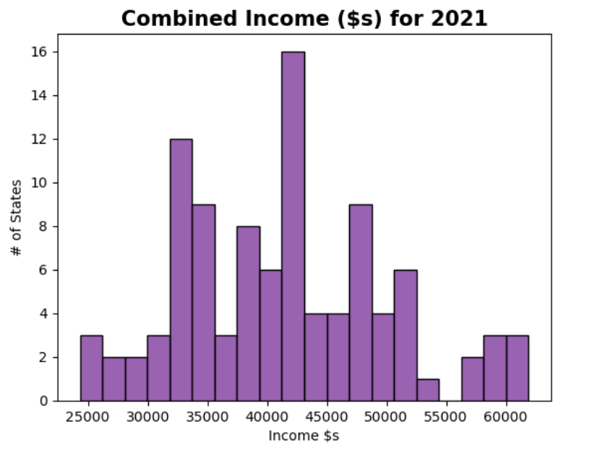
Males vs. Females – Histograms
Annual Income ($s) – Page 2
Observing the combined records for males and females in the United States gives an overall view of the annual income for 2021.
The combined mean is $41,424
The mode is based on gender.
Male = $42,304
Female = $47,011
The combined variance is 755542078.15.
The combined standard deviation is 8691.5.
While there is a $1500 gap in the displayed income, there are no outliers because the incomes are evenly distributed on both ends of the graph. The gap is due to the binning of the results.

Slide 9
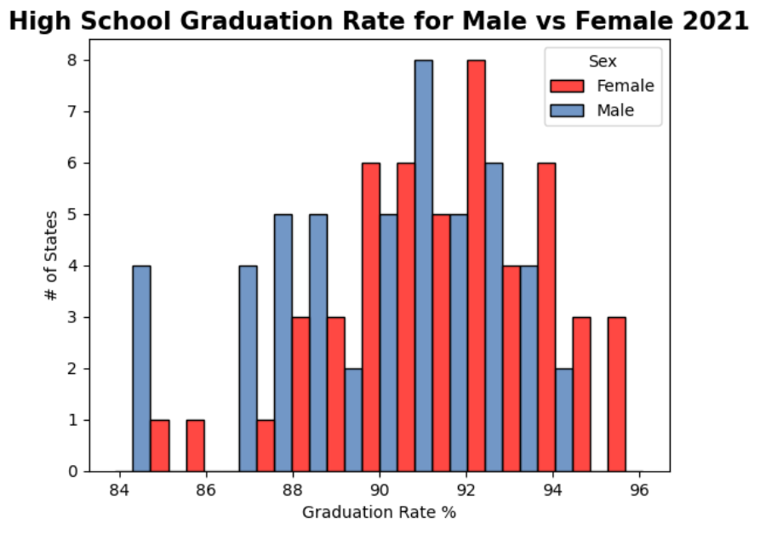
Males vs. Females – Histograms
High School Graduation Rate
39.5% of Men completed high school in 1960, and women had a graduation rate of 42.5%. The numbers increased to 89.9% for men and 91.6% for women in 2021
The maximum graduate rate is 91.6% in favor of women.
The minimum graduate rate is 83.9% for men.
Women dominate the top five graduation rates by state – Vermont (96.1), Maine (95.7), Montana (95.3), New Hampshire (94.7), and Minnesota (94.6).
The lowest five graduation rates by state are a mix of genders – California (83.9M), Mississippi (84M), Louisiana (84.3M), Texas (84.6M), and California (84.9F).
High school graduation rates for men and women have historically been within a few percentage points but have fluctuated on which gender had the most graduates

Slide 10
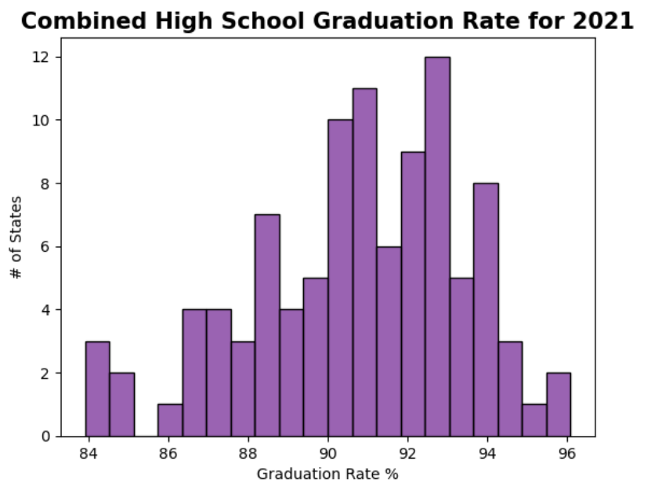
Males vs. Females – Histograms
High School Graduation Rate – Page 2
Observing the combined records for males and females in the United States gives an overall view of the 2021 high school graduation rate.
The combined mean is 90.76%
The mode is based on gender.
Male = 94.1%
Female = No Modes
The combined variance is 7.27.
The combined standard deviation is 2.69.
While there is a less than 1.5% gap in the displayed lower rate, there are no true outliers because the percentages are evenly distributed on both ends of the graph. The gap is due to the binning of the results.

Slide 11
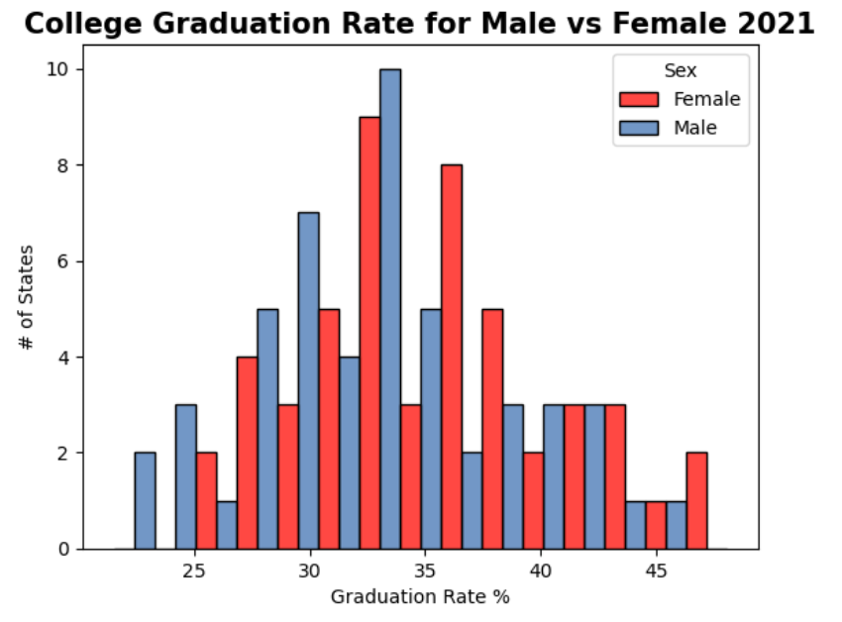
Males vs. Females – Histograms
College School Graduation Rate
College graduation rates have always been considerably lower than high school. In 1960, the graduation rates were 9.7% to 5.8% favoring men. In 2021 the graduation rates are 32.7% to 35.4% favoring women
The maximum graduate rate is 35.4% in favor of women.
The minimum graduate rate is 21.5% for men.
A mix of genders comprises the top five graduation rates by state – Vermont (48.1 F), Massachusetts (47.4F), Colorado (46.0F), Massachusetts (45.8M), and Maryland (43.6F).
Men dominate the lowest five graduation rates by state – Mississippi (21.5), West Virginia (22.8), Arkansas (23.8), Louisiana (24.5), and Kentucky (25.0).
While graduation rates have increased for both men and women because college has become more accessible, it is only recent that women are graduating at a higher rate than men

Slide 12
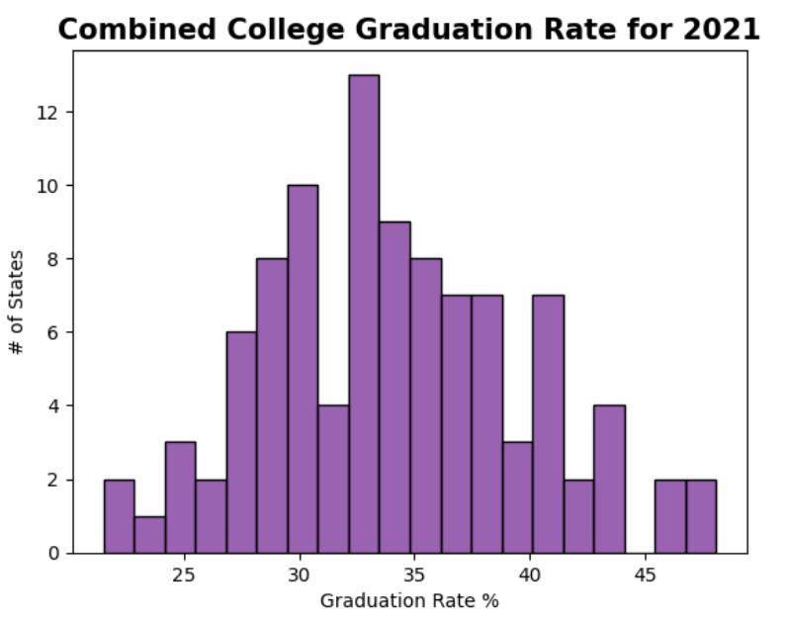
Males vs. Females – Histograms
College School Graduation Rate – Page 2
Observing the combined records for males and females in the United States gives an overall view of the 2021 college school graduation rate.
The combined mean is 34.07%
The mode is based on gender.
Male = 32.3
Female = 33.7%
The combined variance is 32.26.
The combined standard deviation is 5.68.
While there is a less than 1.5% gap in the displayed upper rate, there are no true outliers because the percentages are evenly distributed on both ends of the graph. The gap is due to the binning of the results.

Slide 13
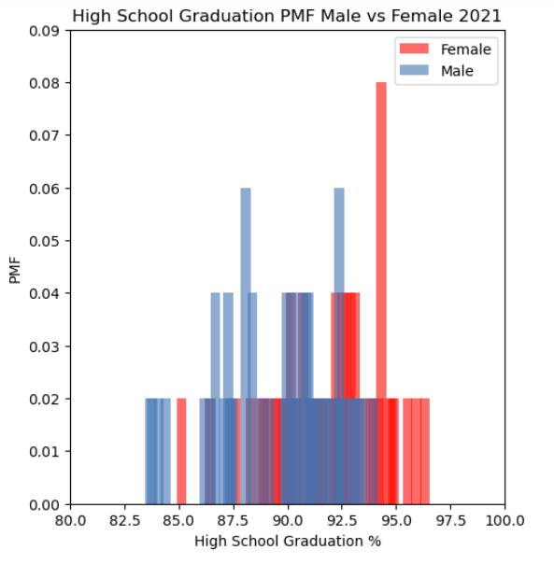
Males vs. Females – PMF Comparison High School Graduation Rate
Comparing the Probability Mass Functions (PMFs) confirms that women graduate from high school at a higher rate than men.
The graph depicts the probability that a given state and gender will have a particular graduation rate. There is a greater chance that a state will have a graduation rate of 94.1% for women than 84.9%. For men, 88.3% and 92.6% have the greatest probability of a state graduation rate.

Slide 14
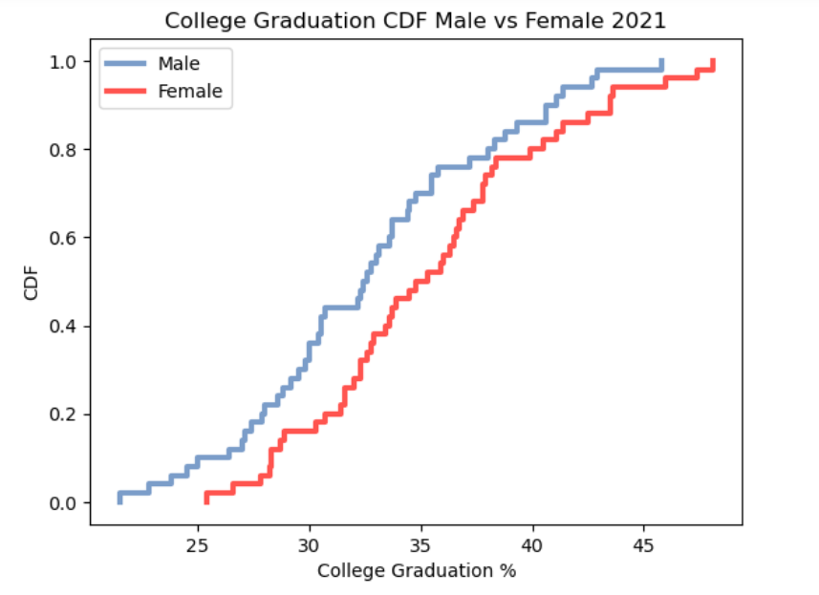
Males vs. Females – CDF Analysis College Graduation Rate
Comparing the male and female Cumulative Distribution Functions (CDFs), a given probability will have a lower state college graduation rate for men than women.
When using a 0.6 probability, men have a graduation rate of approximately <= 33.5%, and women have an approximate rate of <= 36%. At 0.99, the graduation rates for men and women are <= 45.5% and <= 48%, respectively

Slide 15
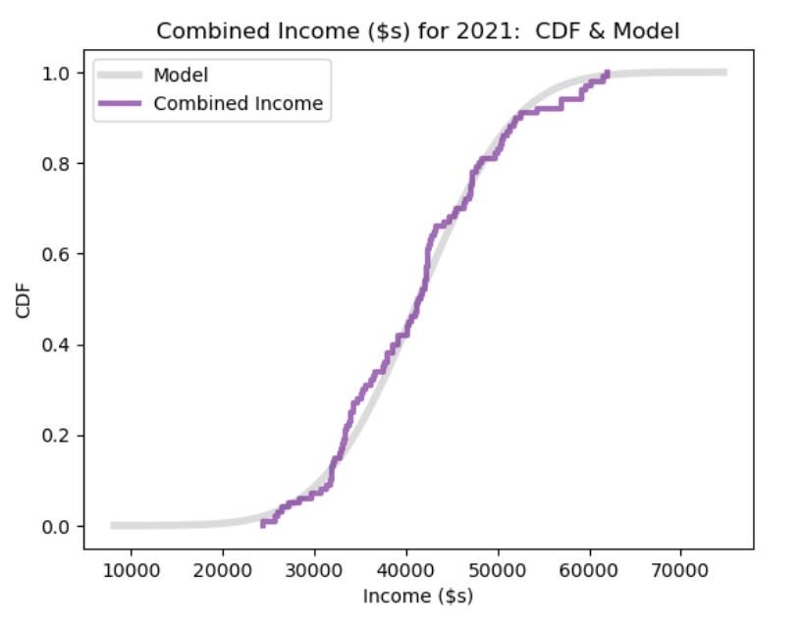
Males vs. Females – Analytical Distribution Income - Compare observed CDF to model
Distributions generally do not create a smooth line; there are "hills" and "valleys.” In this case, the distribution line hugs instead of overlaying the model. The model extends beyond both ends of the distribution, allowing non-existent information to be considered.

Slide 16
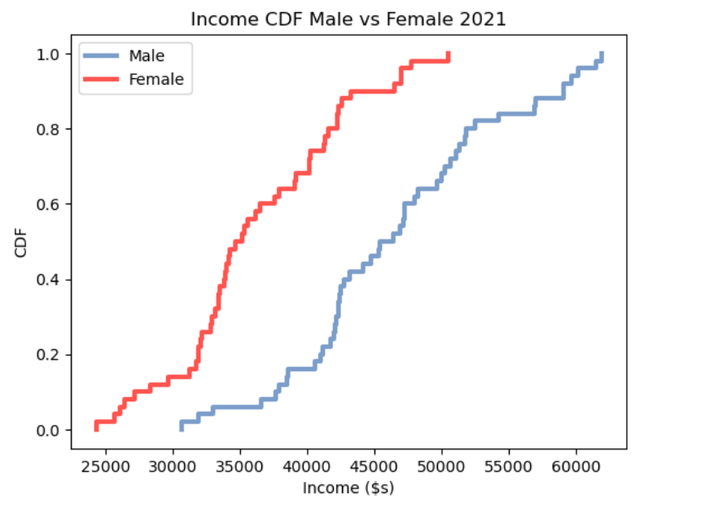
Males vs. Females – Analytical Distribution Income - Compare CDFs
Comparing the male and female Cumulative Distribution Functions (CDFs), a given probability will have a lower annual income by state for women than men.
When using a 0.6 probability, men have a graduation rate of approximately <= $47,000, and women have an approximate rate of <= $37,500. At 0.99, the graduation rates for men and women are <= $61,000 and <= $50,000, respectively

Slide 17
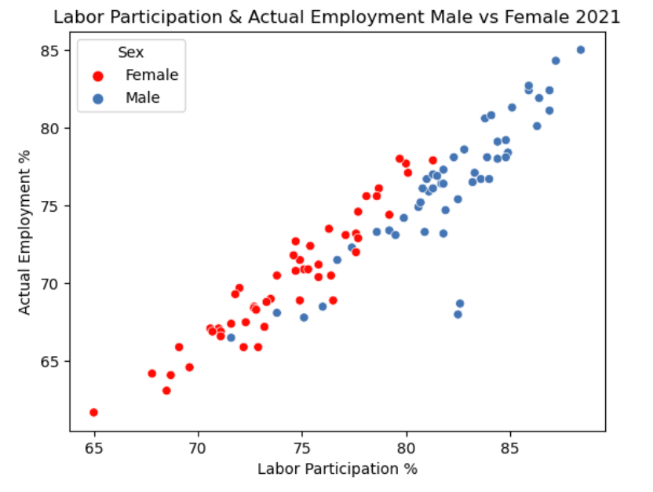
Males vs. Females – Correlation and Causation Labor Participation and Employment
At above 90%, there is a direct correlation between Labor Participation and Employment. This also explains the causation; you have to be available to work and looking for work to ultimately be employed. A covariance greater than 1 reinforces the correlation information.
The combined graph depicts a positive correlation; as the percentage of labor participation increases, so does the employment percentage for each state.
Two outliers also appear for Hawaii and Alaska. These states have more significant seasonal employment: Hawaii due to tourism and Alaska because of weather and the remote population location.
Covariance = 25.58
Pearson Correlation = 0.930
Spearman Correlation = 0.920

Slide 18
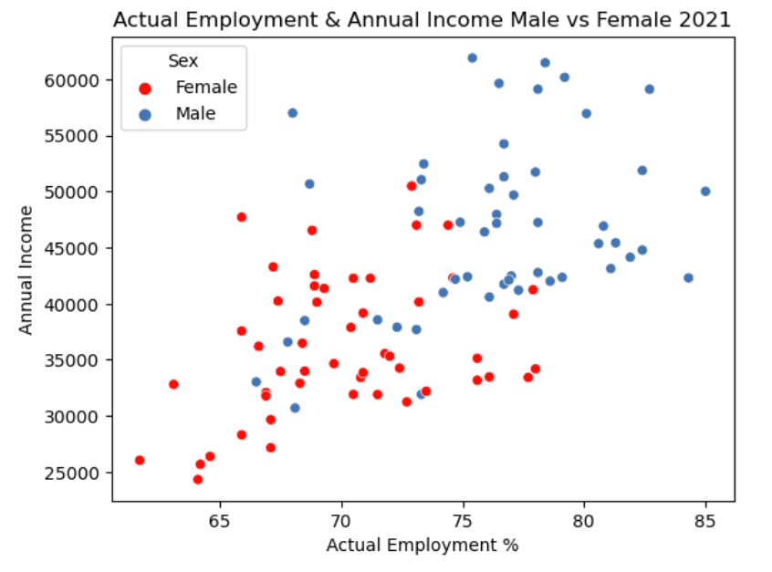
Males vs. Females – Correlation and Causation Employment and Income
At approx. 55%, there is a weaker correlation between Employment and Income. A larger state employment rate leads to a greater annual income per state. A covariance greater than 1 reinforces the correlation information even when a percentage and a large number are compared.
The combined graph depicts a positive correlation since it is trending upward; as the percentage of employment increases, the annual income may increase for each state.
Covariance = 26023.45
Pearson Correlation = 0.578
Spearman Correlation = 0.595

Slide 19
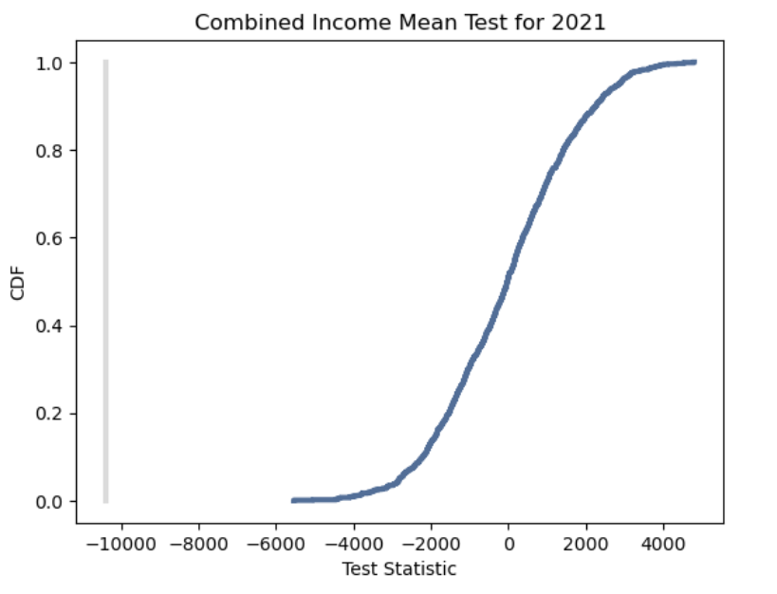
Males vs. Females – Hypothesis Testing Women make 83% of Men's Income.
It is commonly thought that the average woman's income is 83% of what men make. The Status of Women in the United States website says it's 79.2%. After creating the means of all the state's incomes by gender and comparing the mean incomes of men to women, women make 77.7% of the mean of men's incomes.
The P-Value = 1.0
The Mean of women’s Income = $36229.78
The Mean of men’s Income = $46619.62
The Income of Women is 77.71% of Men

Slide 20
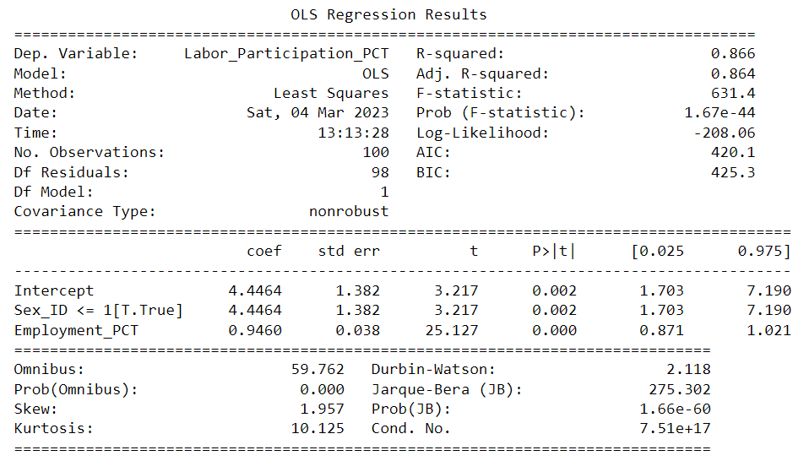
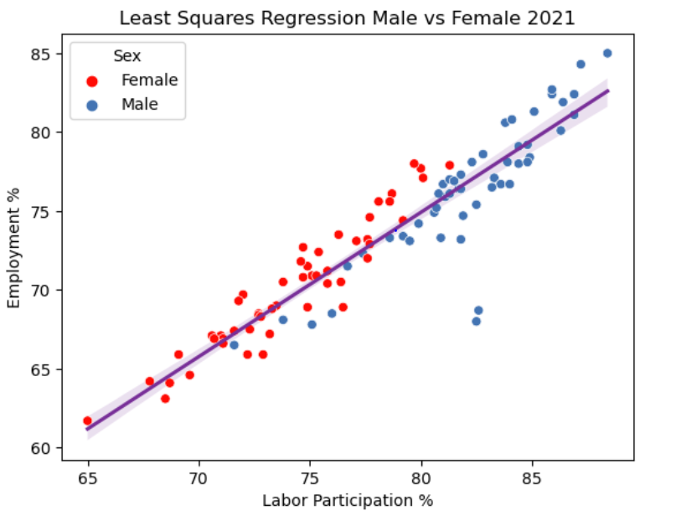
Males vs. Females – Least Squares Regression Labor Participation and Employment
This represents a positive correlation, and the clustering around the regression line depicts the closeness of the relationship between Labor Participation, and Employment, the R-squared of 0.866 reinforces that this is a positive linear relationship.

Slide 21
Males vs. Females – Conclusion
The historically significant differences in education, employment, and income have shrunk considerably. Women have recently surpassed men in high school and college graduation rates. The difference in labor participation and employment rates has dropped from over 40% to single digits. Women have made great strides in closing the wage gap from 40% to 23%, and by the year 2058, women may begin to approach income equality.
National trends in education, employment, and income show increased percentages nationwide. Yet, there is still a long way to go.

